Slide 1
Final lecture! You did it!
You are Awesome!

Slide 2
Today:
How to export app for google play
How to publish app in google play
How to boost downloads
What to do next

Slide 3
Publication app in google play
And what to do next

Slide 4
Prepare .APK file

Slide 5
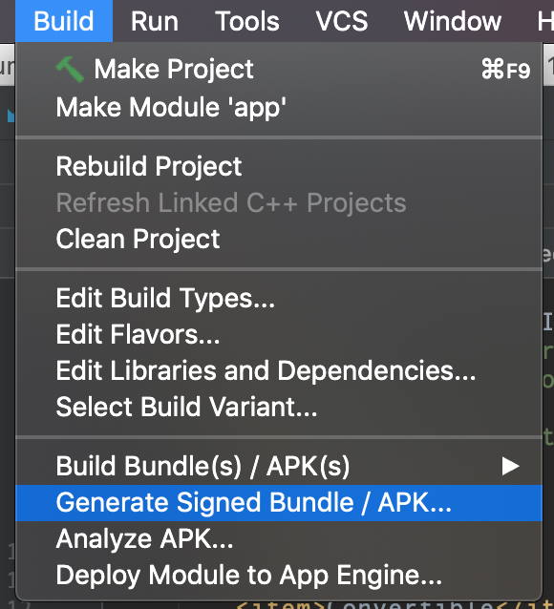
Prepare .APK file
Build in release and sign apk

Slide 6
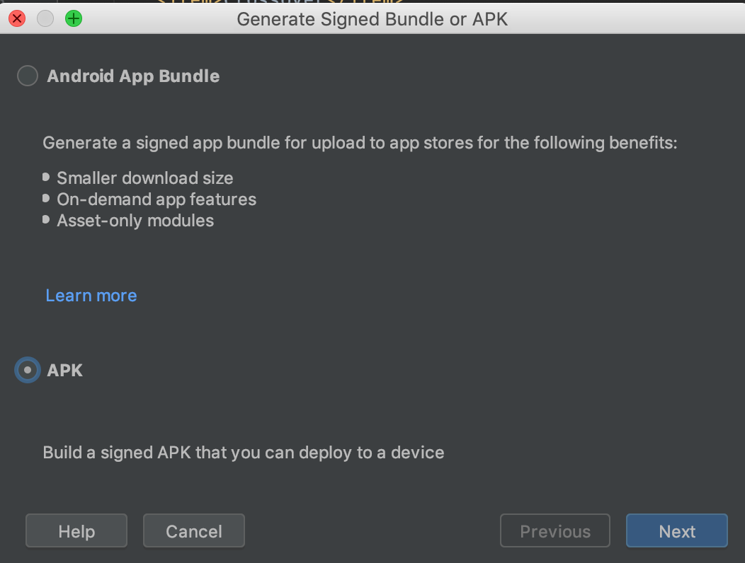
Prepare .APK file
Select any of those options
Android App bundle – new way
APK – old way

Slide 7
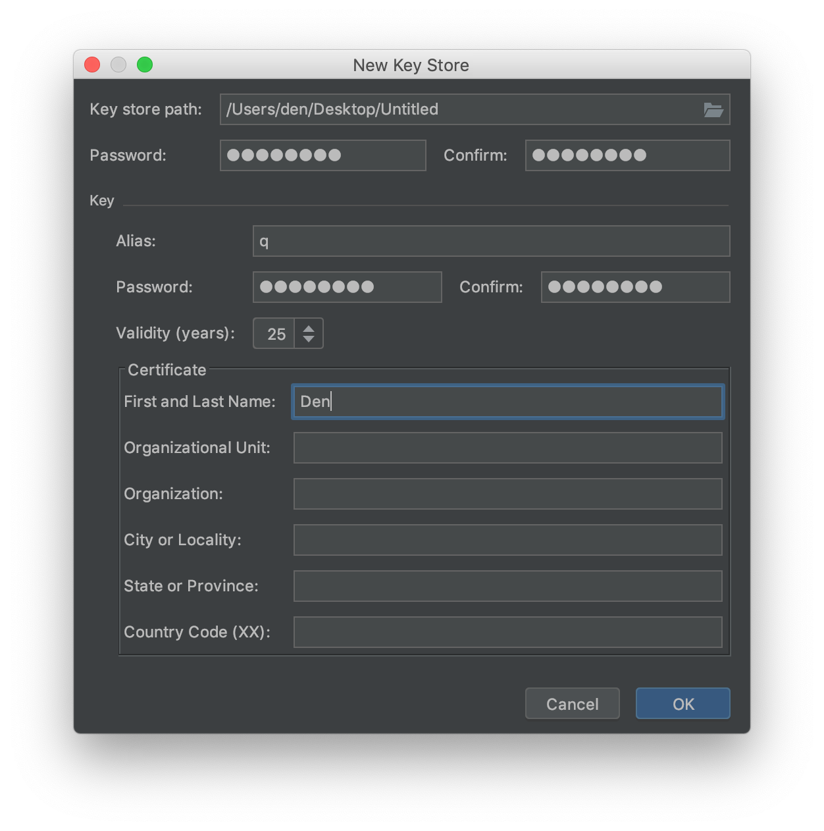
Prepare .APK file
Key path
Password
Alias
At least 1 param in cert
DO NOT LOSE IT, it cant be restored!

Slide 8
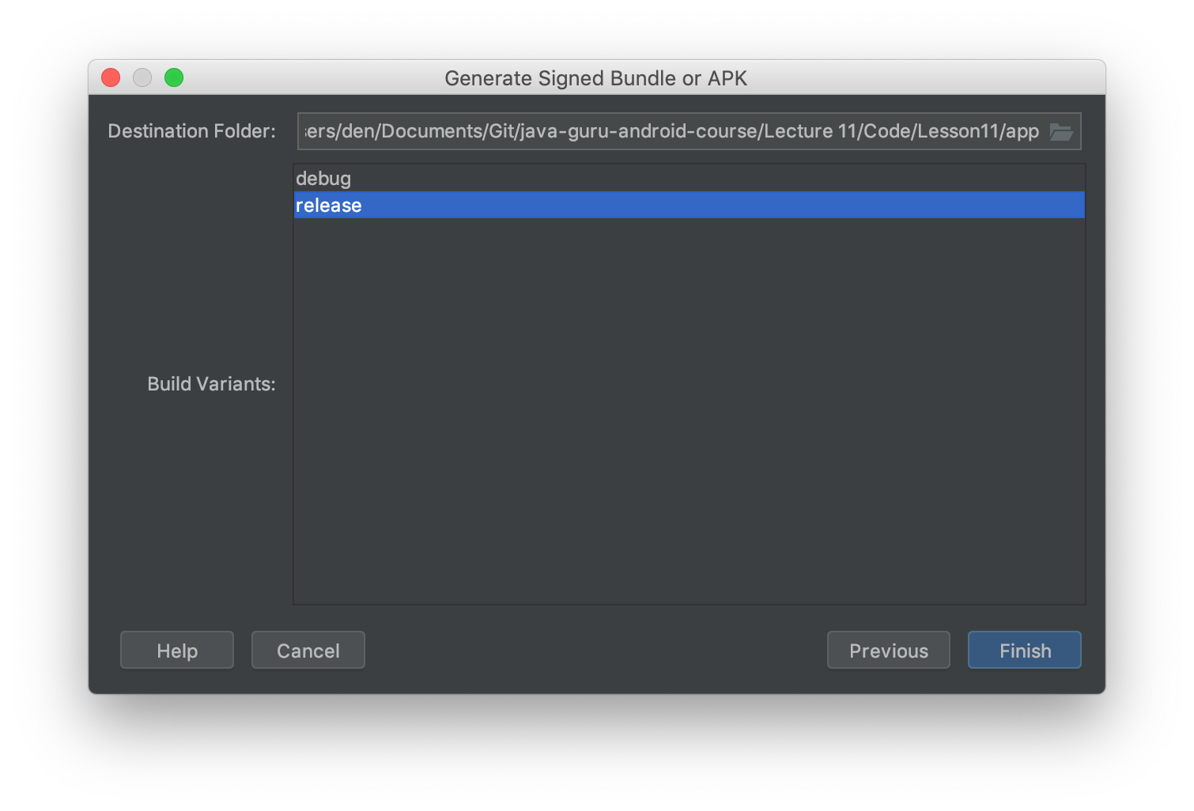
Prepare .APK file
Select release and click finish

Slide 9
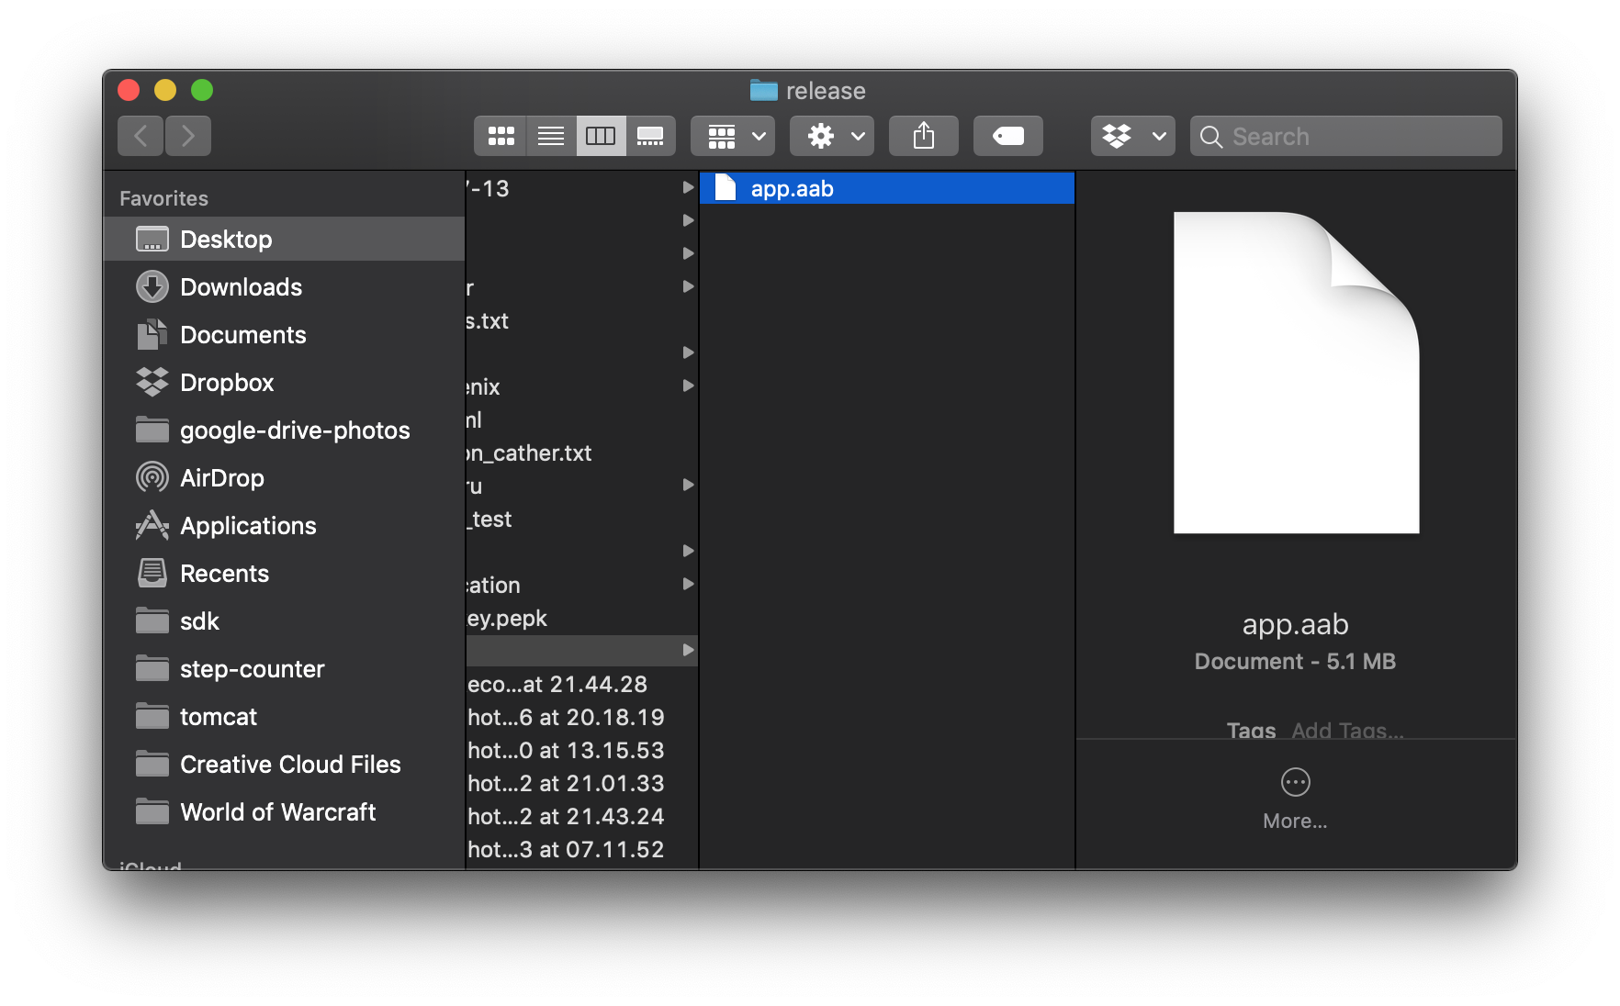
Prepare .APK file
Locate file
For first method, it would be .aab
For second method, apk

Slide 10
Prepare Assets for Google Play

Slide 11
What you need
Signed App
App name, app short description
App description (text, max 4000 symbols)
App Icon 512x512
App banner 1024x500
2 screenshots
Public privacy policy

Slide 12
Privacy policy
Take file from that lecture, search and rename inside
YOUR NAME
APP NAME
Publish that file on https://pages.github.com/ (free)
Example https://taier.github.io/privacy-policy/step-counter/

Slide 13
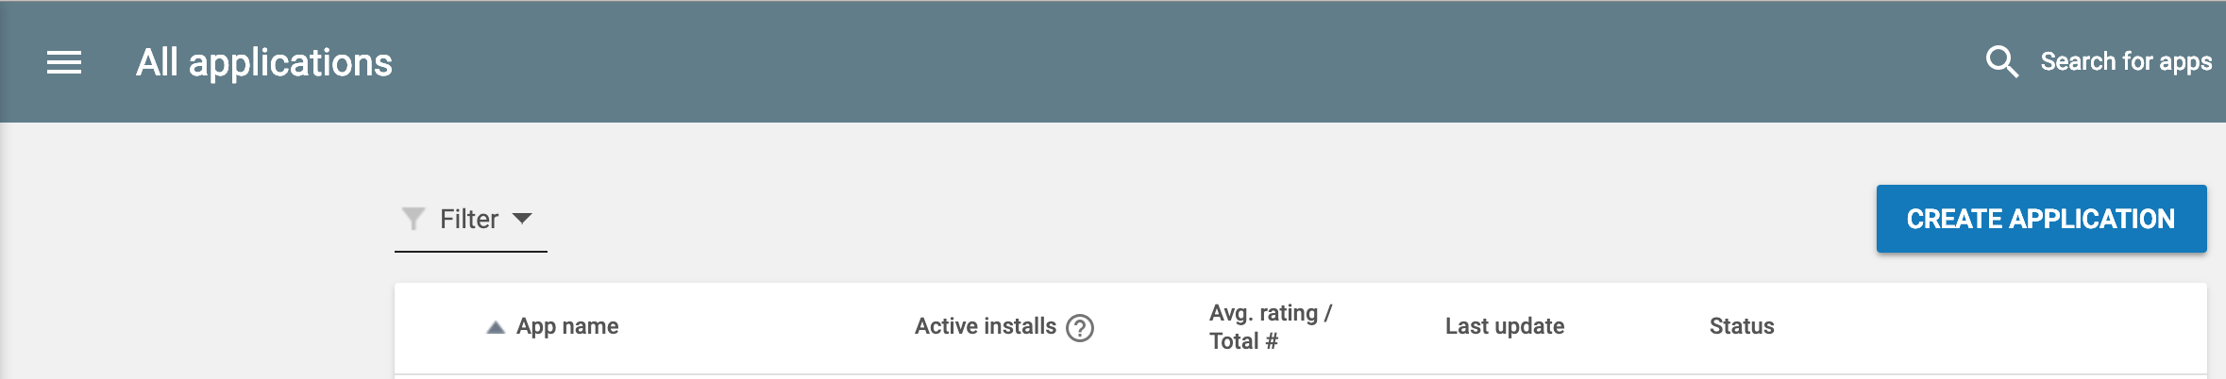
How to publish app
Click Create Application

Slide 14
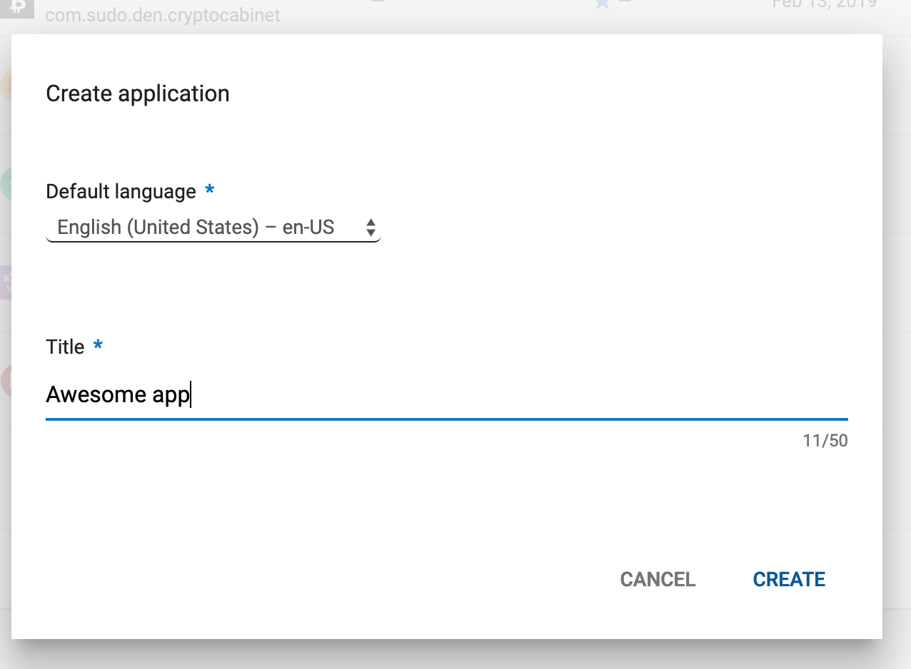
How to publish app
Select default language
Fill Title of the app

Slide 15
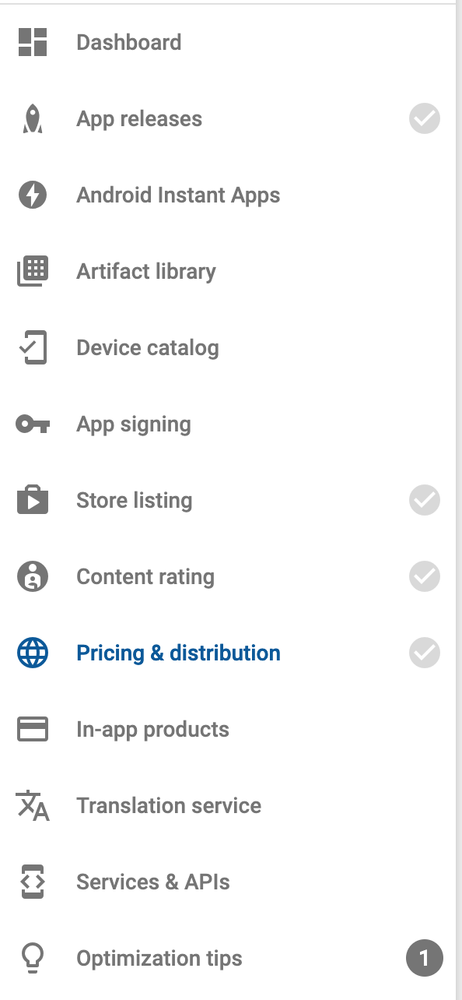
How to publish app
This panel would guide you on what needs to be done

Slide 16
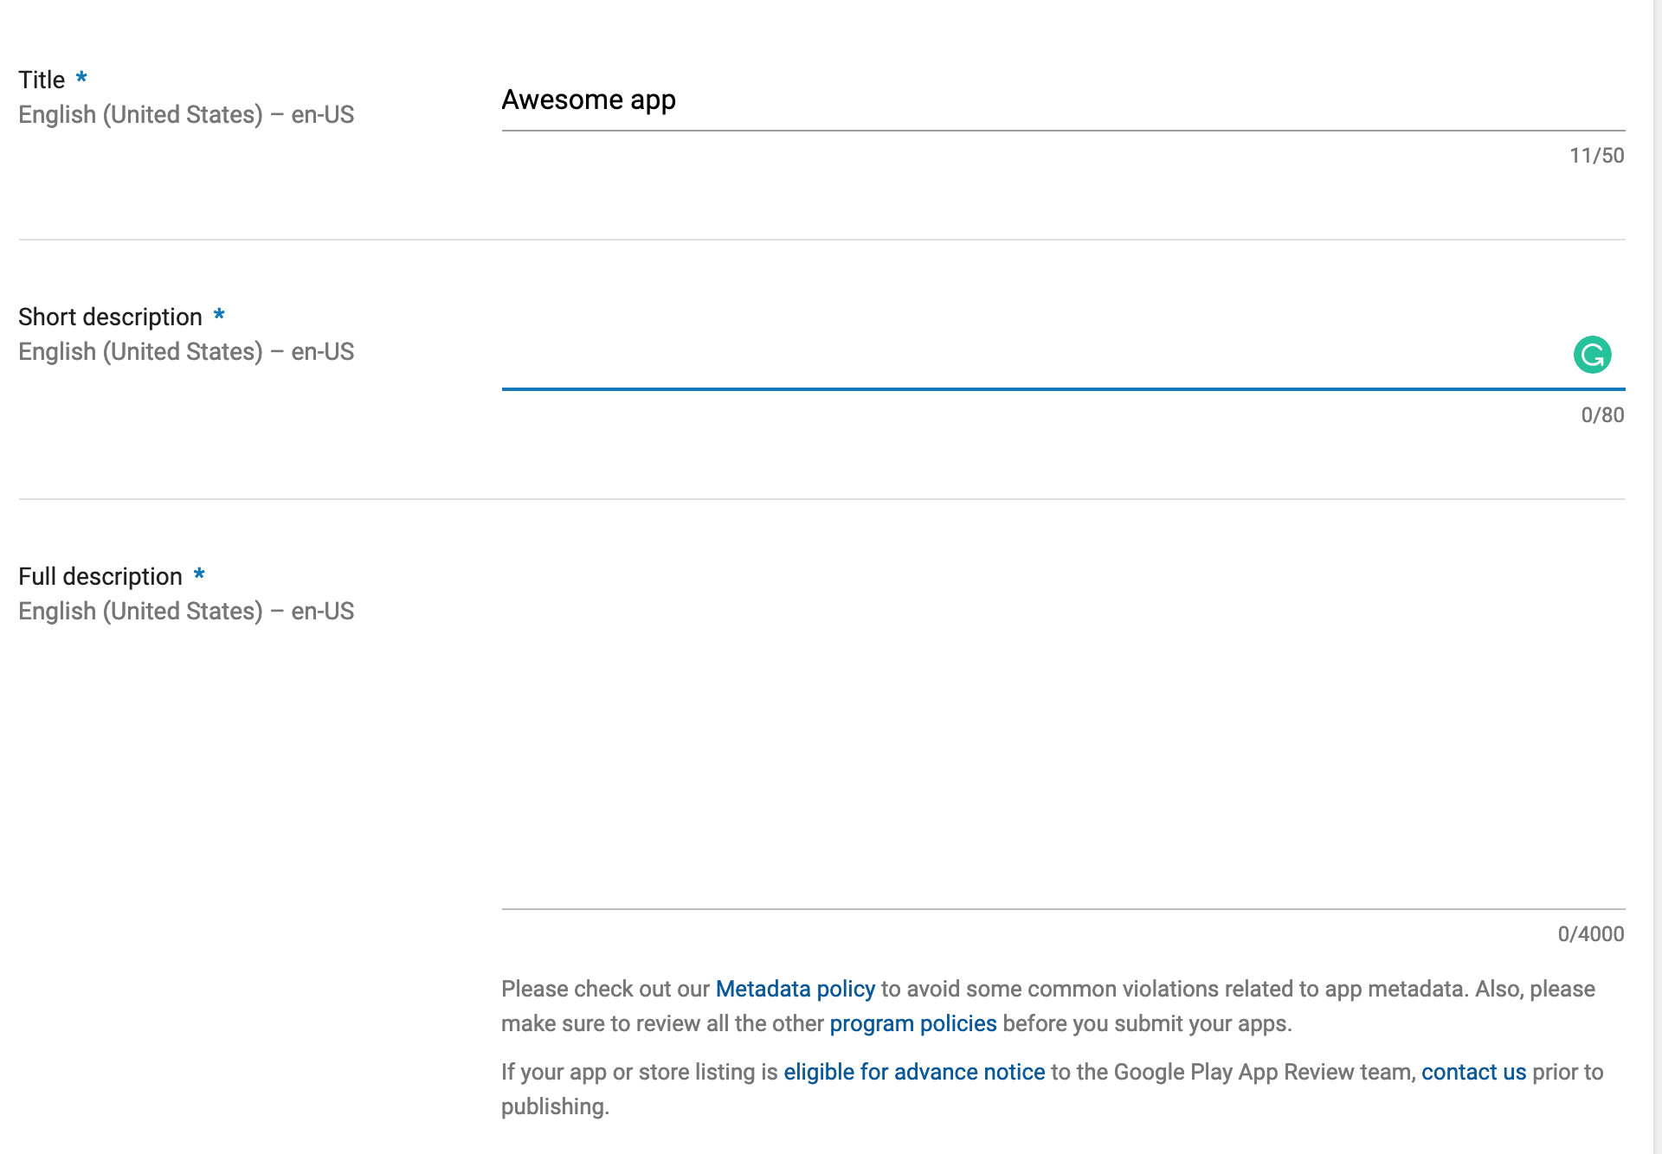
How to publish app
Add short description
Add full description

Slide 17
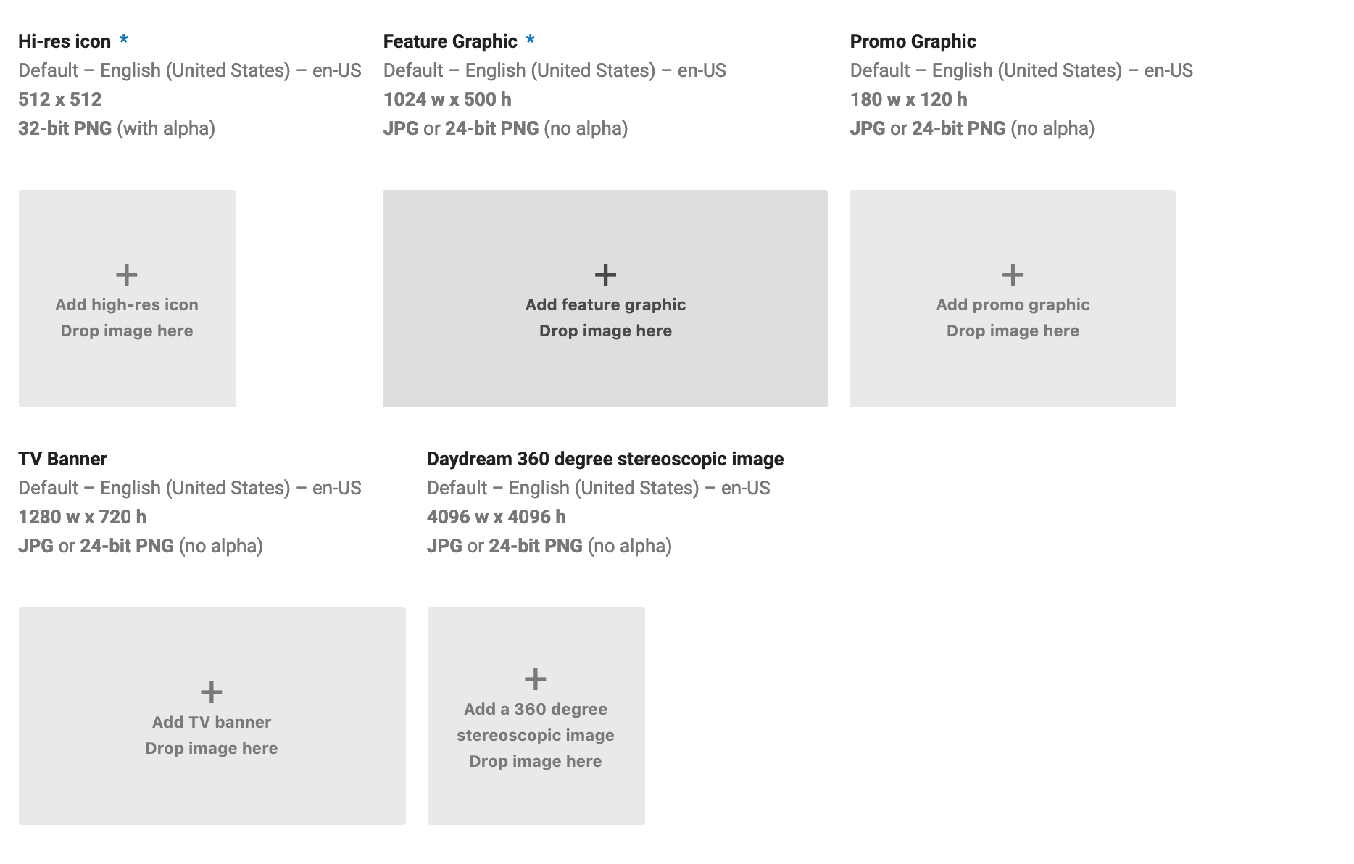
How to publish app
Add Icon
Add Banner

Slide 18
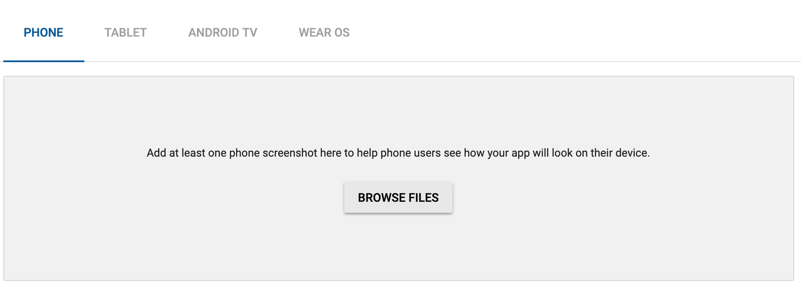
How to publish app
Add at least 2 screenshots

Slide 19
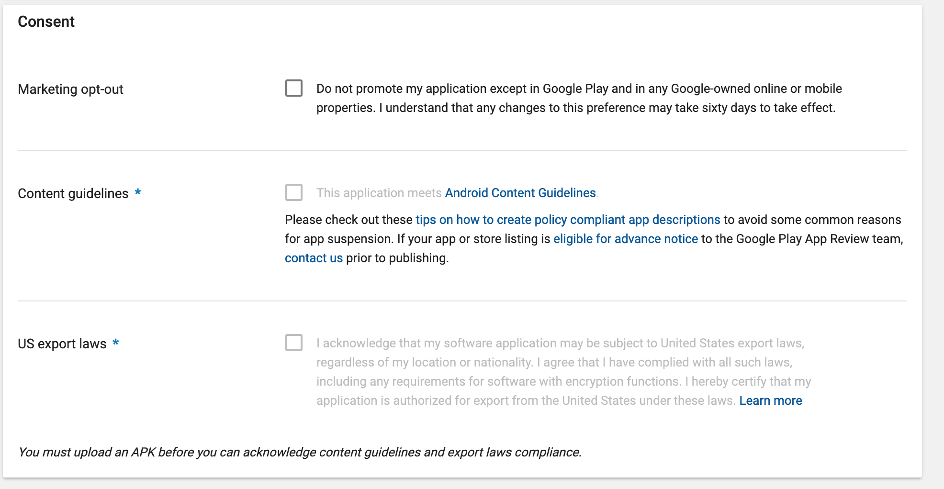
Continue selecting stuff

Slide 20
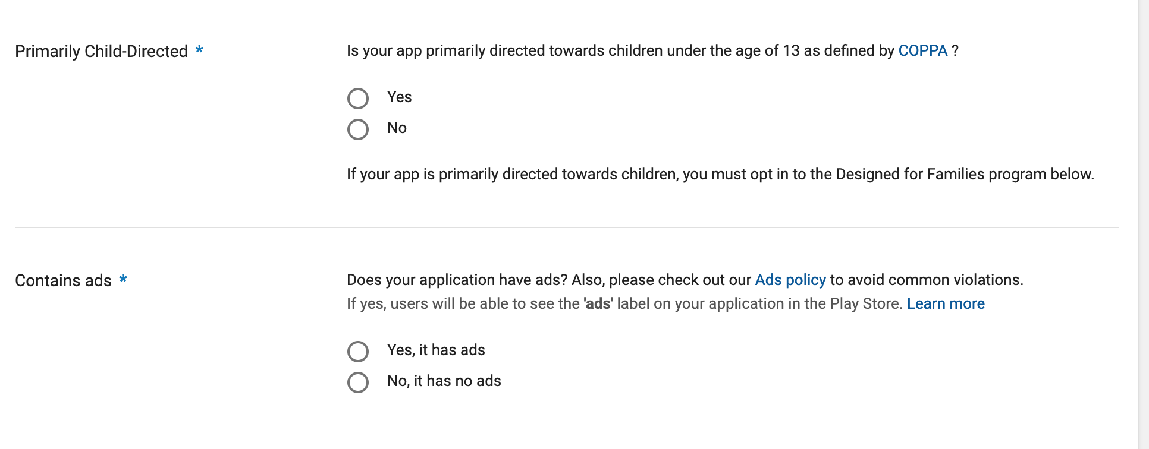
Mark that app contains aDS (if contains)!

Slide 21
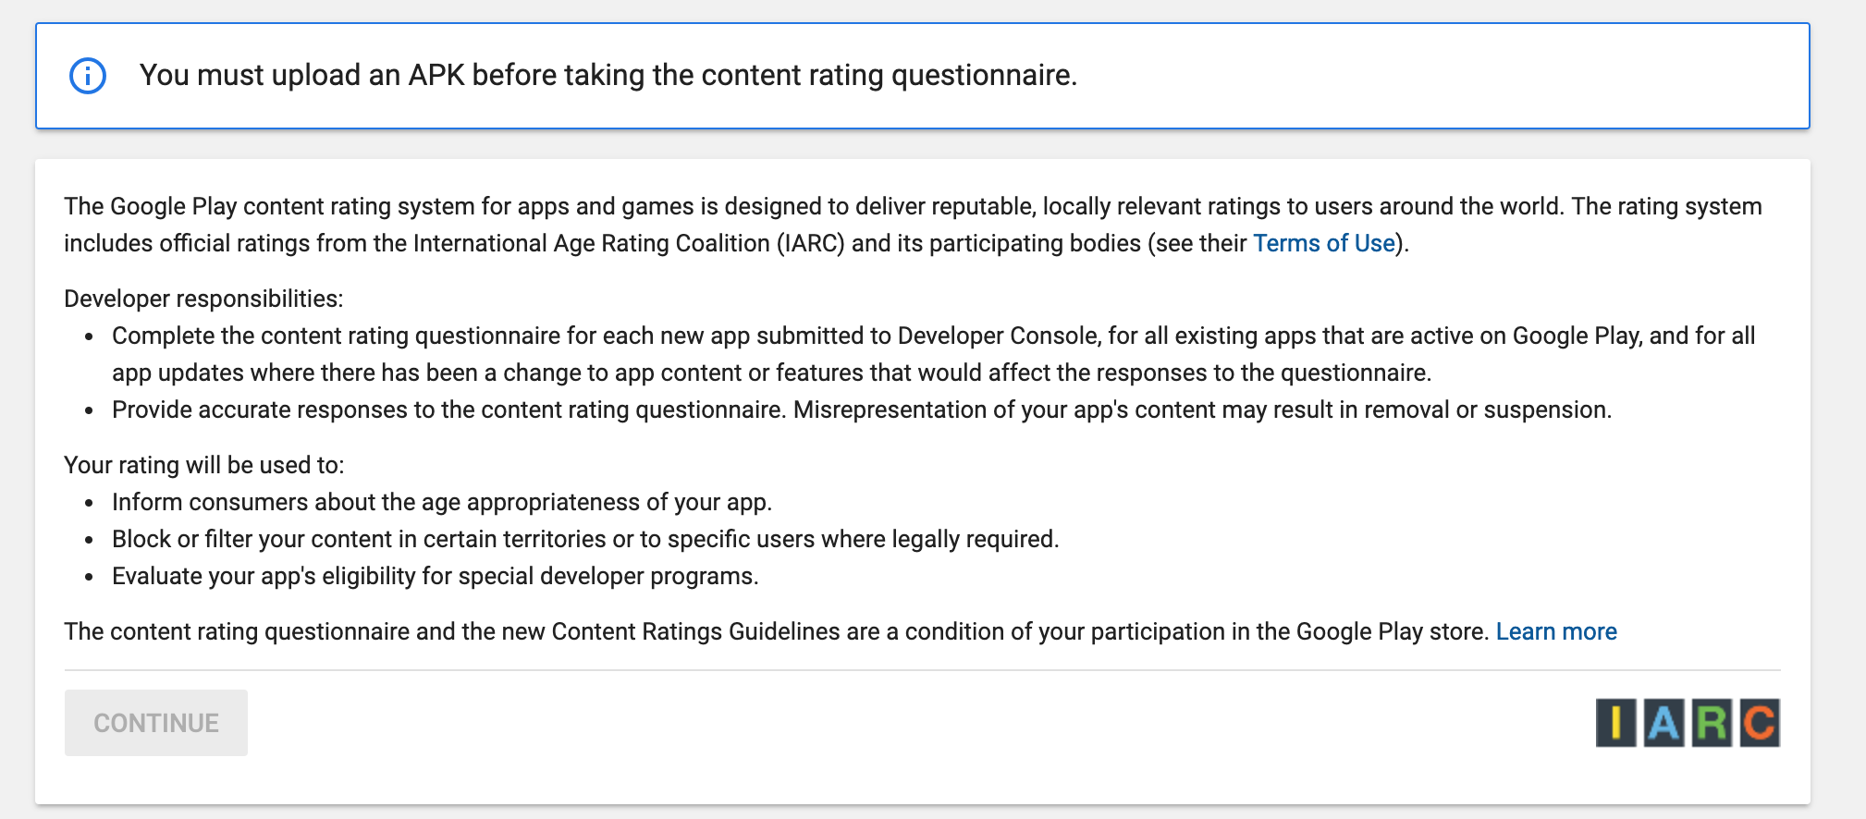
How to publish app
Generate a rating by answering a few questions

Slide 22
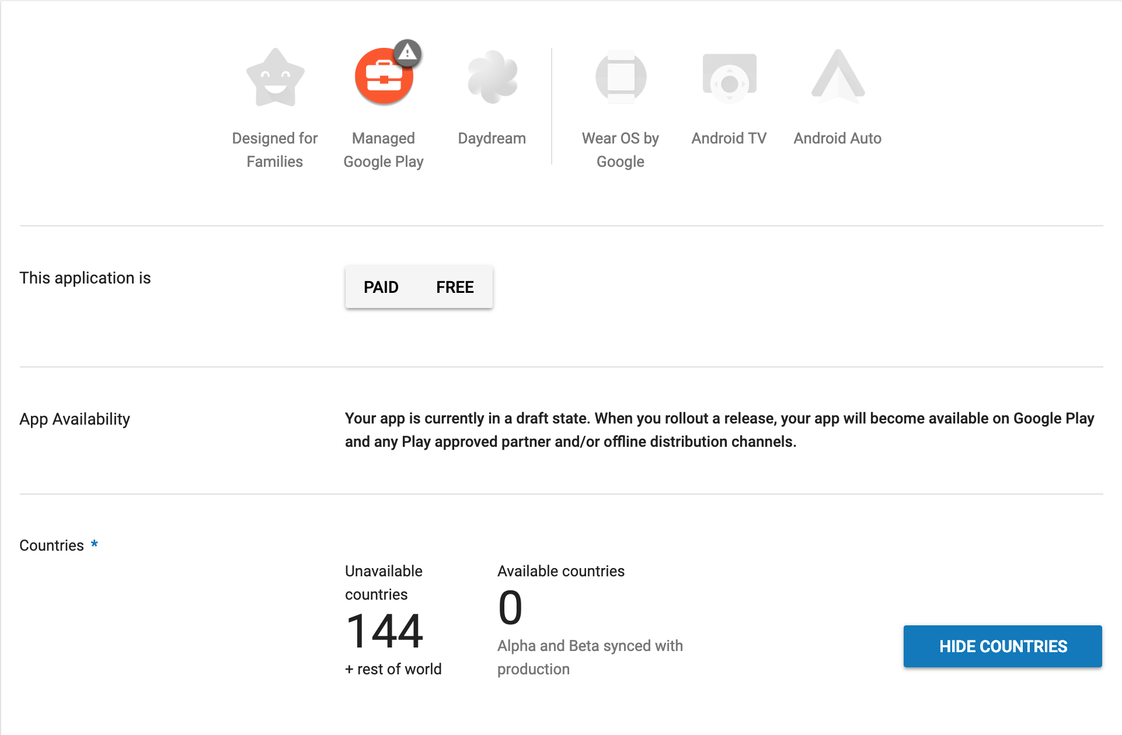
How to publish app
Set price

Slide 23
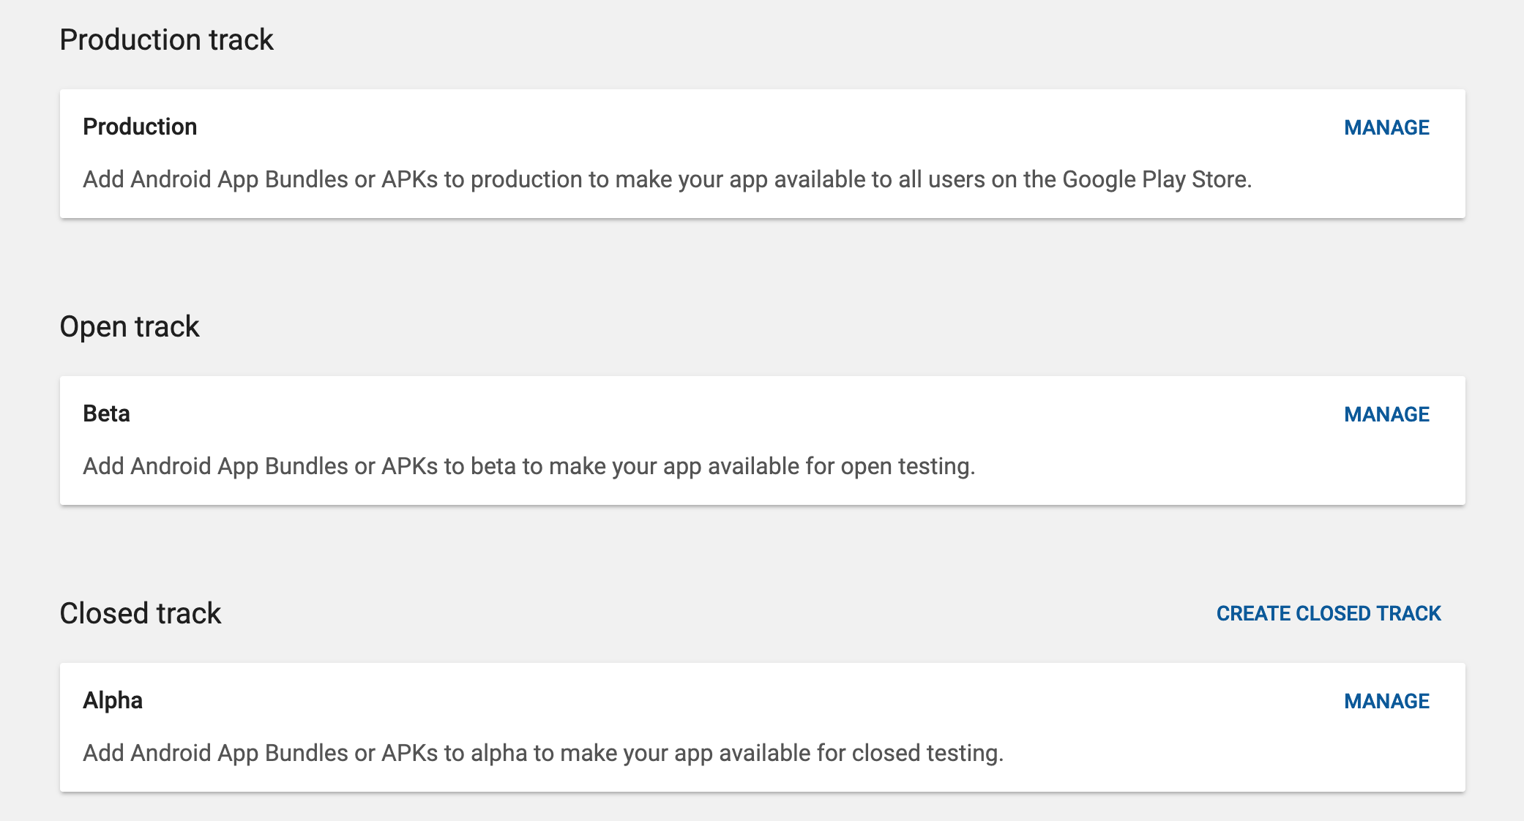
How to publish app
Go to releases and upload an apk/aab file
You could upload first to beta in order to test it by downloading from google play by yourself only

Slide 24
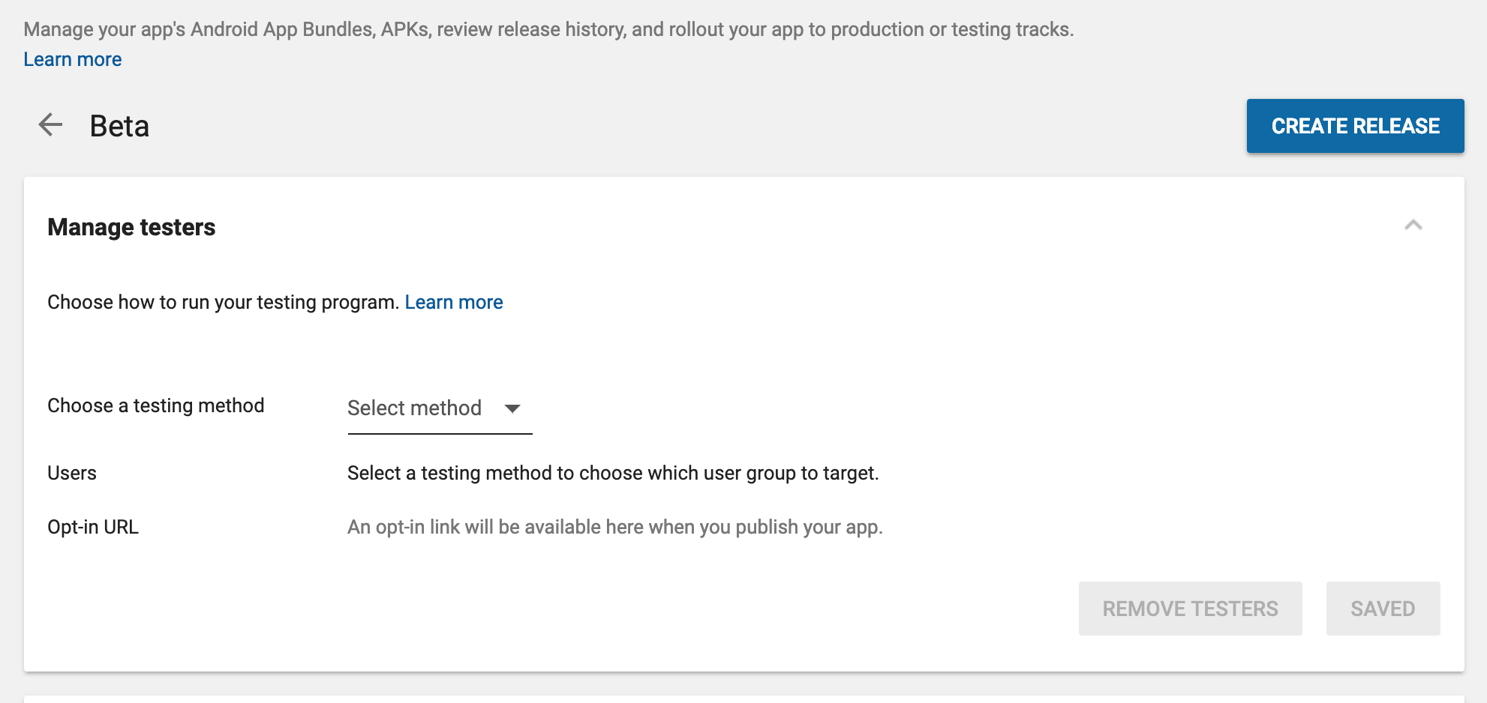
How to publish app
Add test user (if you select beta)
Select create release

Slide 25
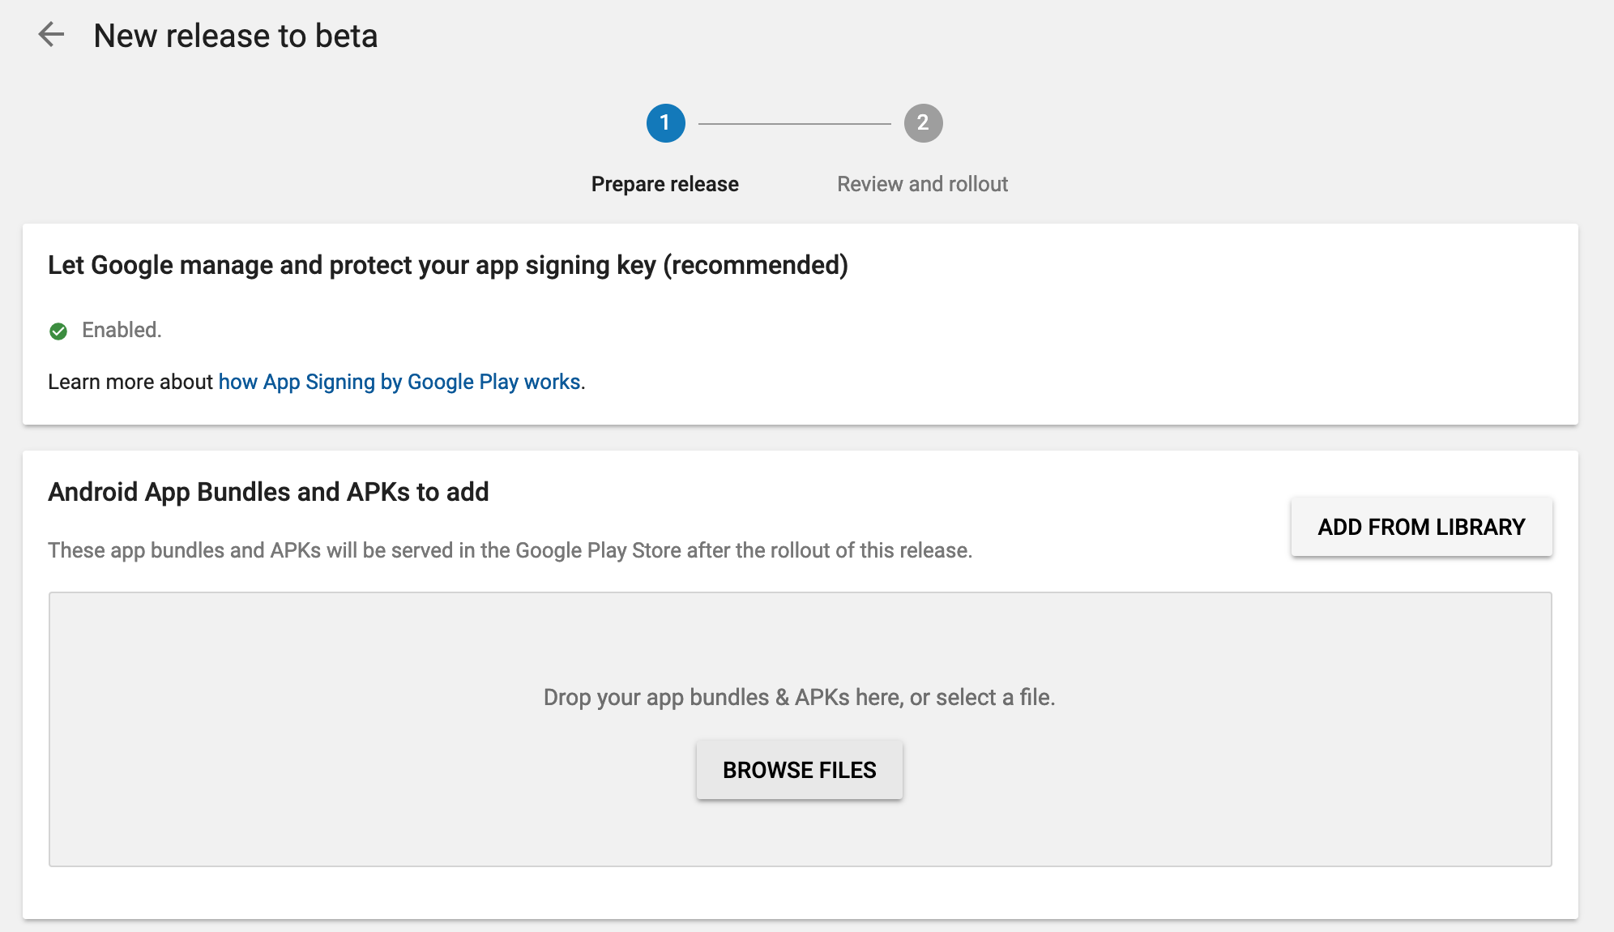
How to publish app
Upload exported file

Slide 26
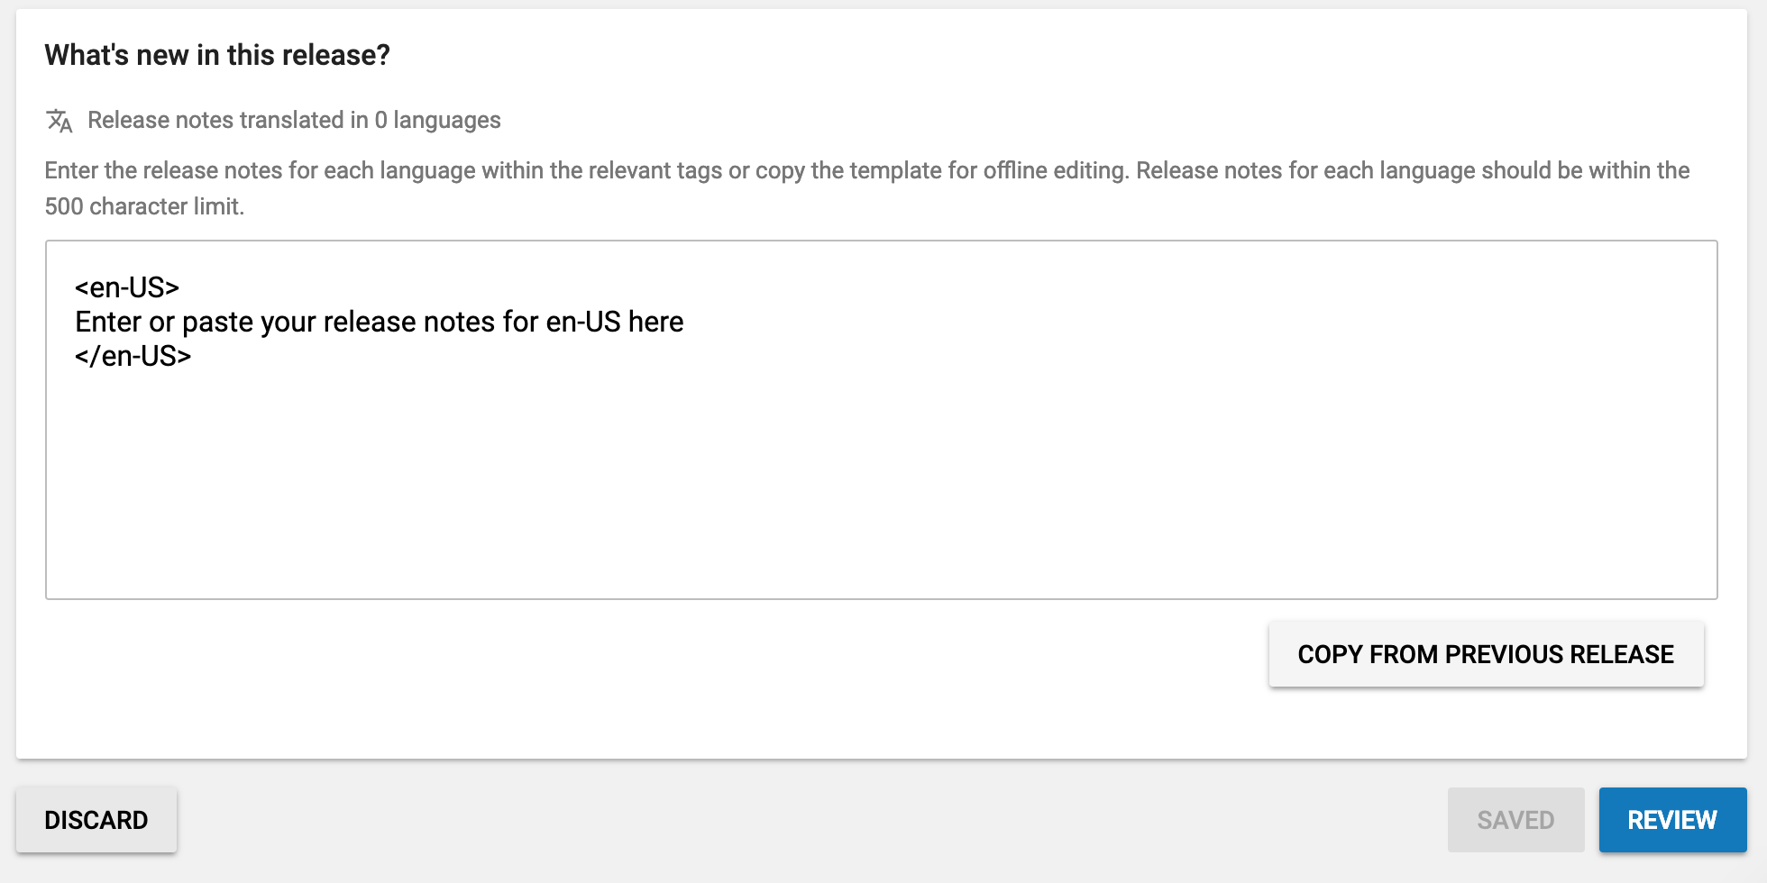
How to publish app
Add whats new and press review
If all items are filled, your app would be visible within a 30 minutes – 1 hours to the whole world!

Slide 27
Tricks to boost downloads

Slide 28
Translate you app
Your app would appear for keyword in different languages
Don’t forget to to localize your screenshots!
Replay to reviews by the same language the review was written!

Slide 29
Add rating module
Position in store depends on number of reviews and the rating itself
People tend to only rate bad if something working. If all works good – you better to ask for review ☺
Good library for that https://github.com/codemybrainsout/smart-app-rate
Try to ask for feedback if something is not working, if you resolve user problem it would become your best customer!

Slide 30
Buy some installs
It would put your app higher in chart and then organic people would download it!
You could start registration on adWord (google) and just don’t click pay button. Leave page.
If a one-two week timeframe you would receive a mail with voucher for ~40 Euro, that would apply if you complete registration and spend at least ~12 Euro. After receiving it, complete registration ☺ and buy installs!

Slide 31
What to do next

Slide 32
What to do next
Your own aps after work
Freelance
Find work locally

Slide 33
Your own aps after work
+
No stress ☺
Possibility for a passive income
Good portfolio
Express yourself
-
Long time to see income
May lose motivation (life gets in the way)

Slide 34
Your own aps Suggestions
Find a place where you could do 1:30-2h work without distractions
library (LU, central biblioteka, LNB)
Co-working (~100 Euro, techhub, people-work)
Plan releases (1.0, 1.1, etc)
Plan features for each release
make deadlines for yourself
Define what is enough

Slide 35
Freelance
+
New income stream
You learn new stuff and earn money ☺
Interesting projects
Can go fulltime at some point
-
Hard to find first clients
First gigs would be stressful
Need to spend time on managing not coding

Slide 36
Freelance Suggestions
Fill as many info as you could, put a real photo, look how others highly payed freelancers fill their info and copycat with some adjustments ☺
Prepare introduction that you would send, but change it a little to reflect binding project
Do English tests if possible to earn badge

Slide 37
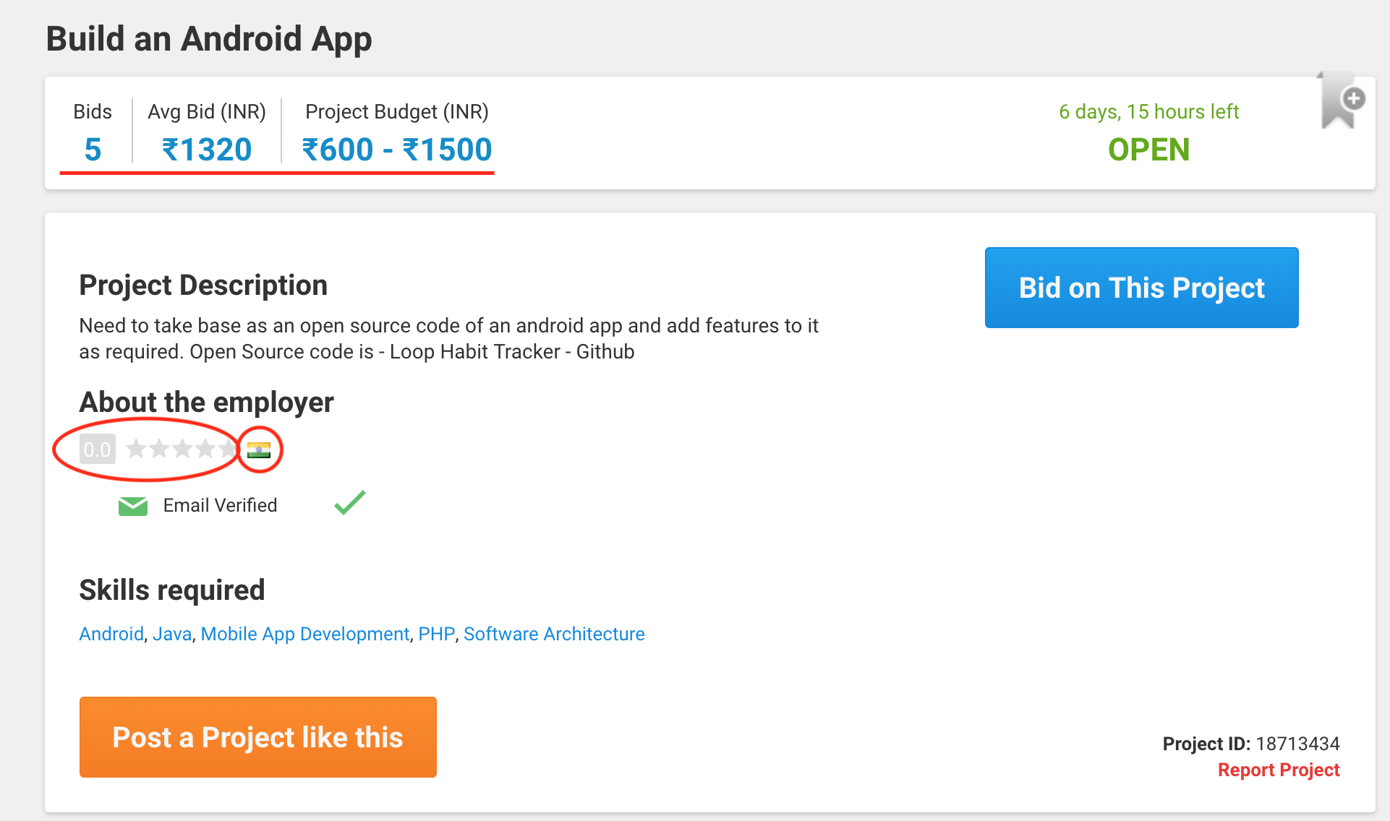
Most likely a bad project
Price in ruby
Employer location – India
Not clear what to do
No rating
Don’t even spend a binds for such projects

Slide 38
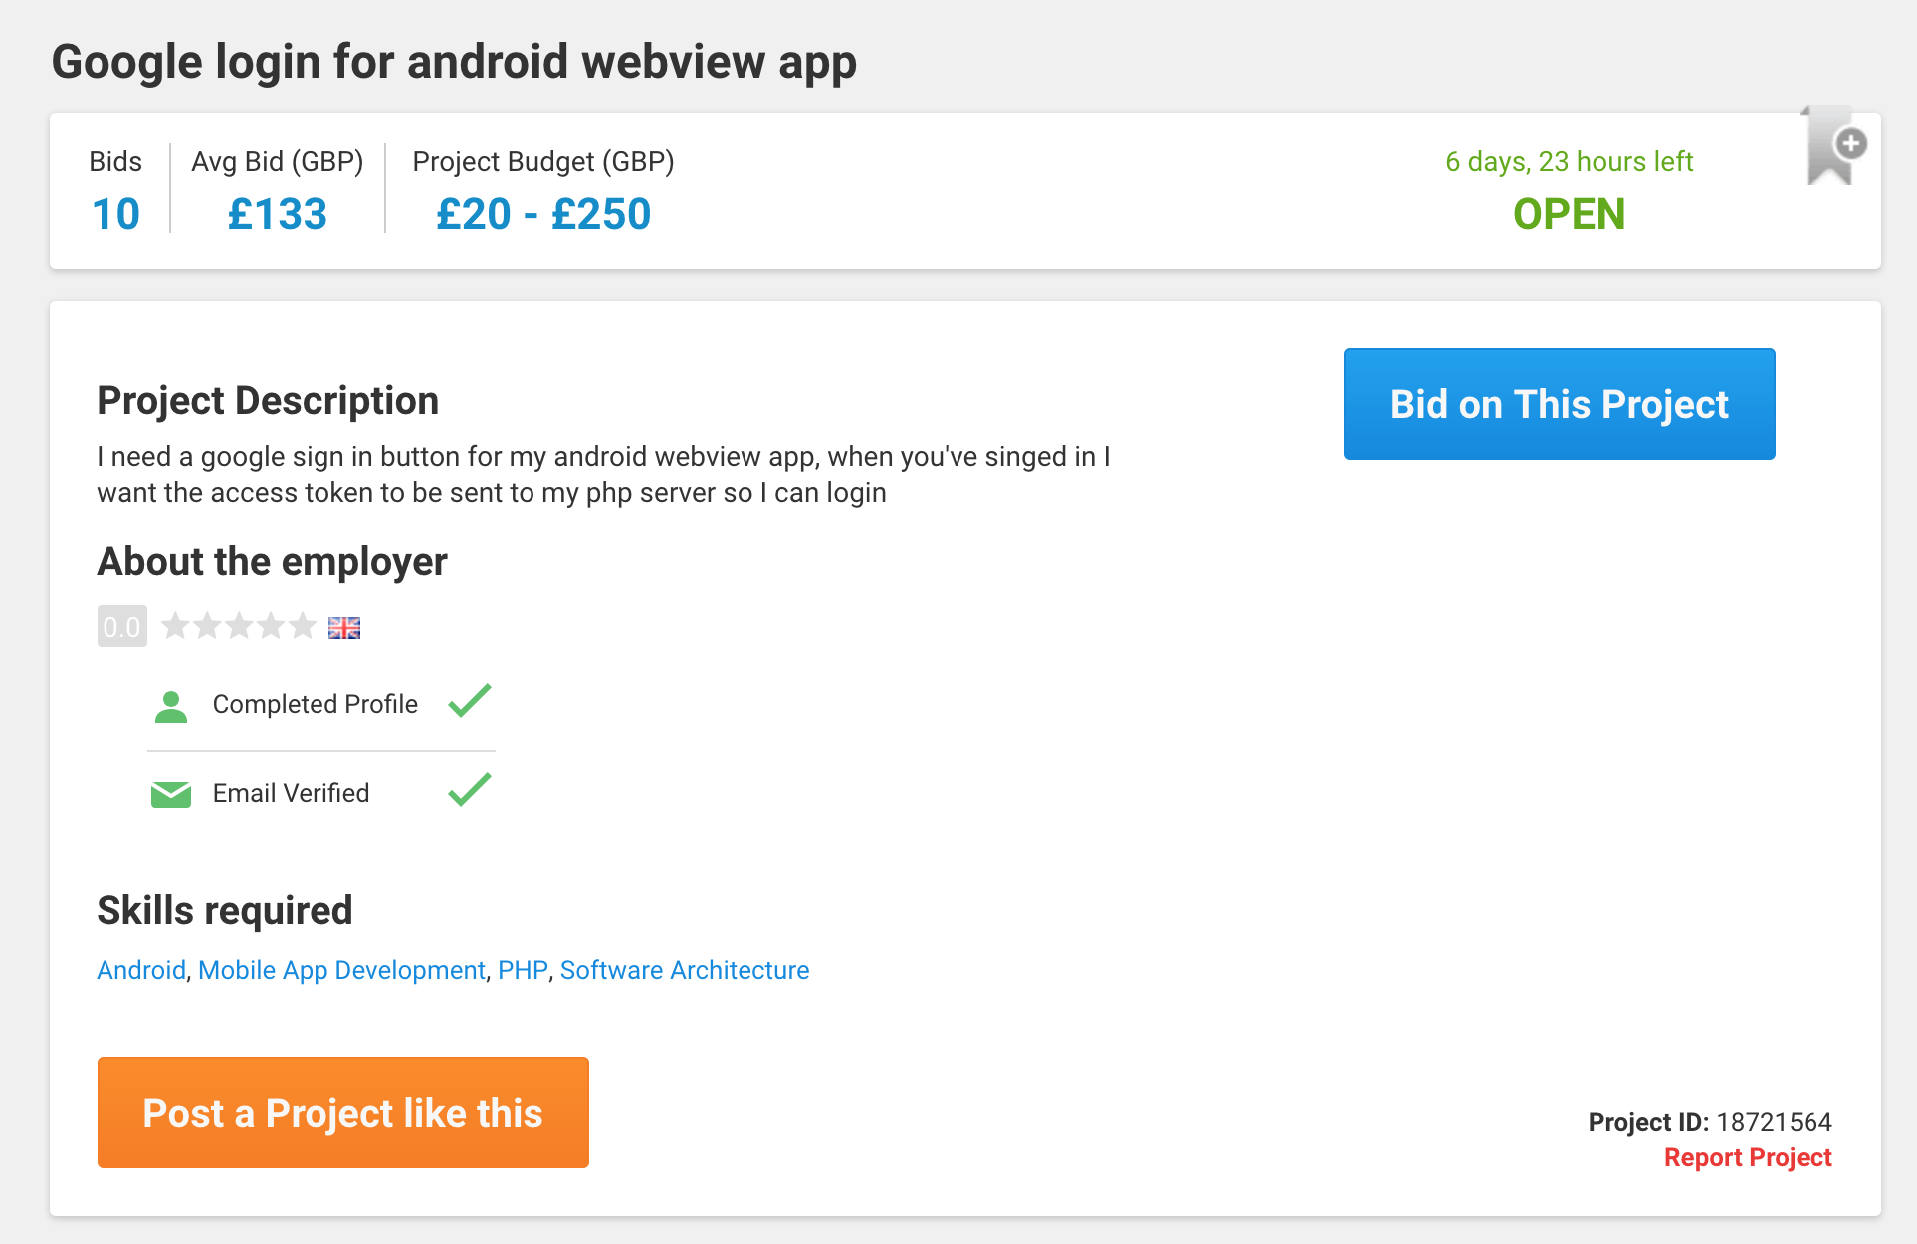
Most likely a good project
Country UK
Clear what to do
Note: no rating, maybe pro freelancer would not bind

Slide 39
Place to start
https://www.freelancer.com
Site takes 10% (earn 100, receive 90)
Possible to find a starter project with minimal portfolio
Does not take VAT upfront (21%)
Allows 8 binds in month for a free plan

Slide 40
Find local job

Slide 41
Find local job
CV.LV
Go to local meetups, HR came there regularly (meetup.com, search for mobile/Android, facebook grounds)
Look for Junior/Trainee position, but not afraid to apply for mid as well
Even if you fail, would know the requirements. Always ask for feedback!
If you continue in learning, you would become middle much faster than others because of foundations of this course

Slide 42
TODO:
LinkedIn profile – its like a twitter for HR, they retweet your profile between each other
PDF version as well
Github with some code that you play with, (for example this course app) or any other that you could build using online tutorials. Make sure it has a good readme.md file with description about what that project can do
Published aps in google play – if you could do that, you would be ahead of lots of people

Slide 43
Better CV
Write what you did (build thing, increase revenue, solve a business problem)
Architectures that you know (MVC, MVP, MVVM)
Frameworks that you could work with (Glide, Butterknife, etc)
Infrastructure (Git, Jira, scram, etc)
Languages (Java)

Slide 44
Continue learning

Slide 45
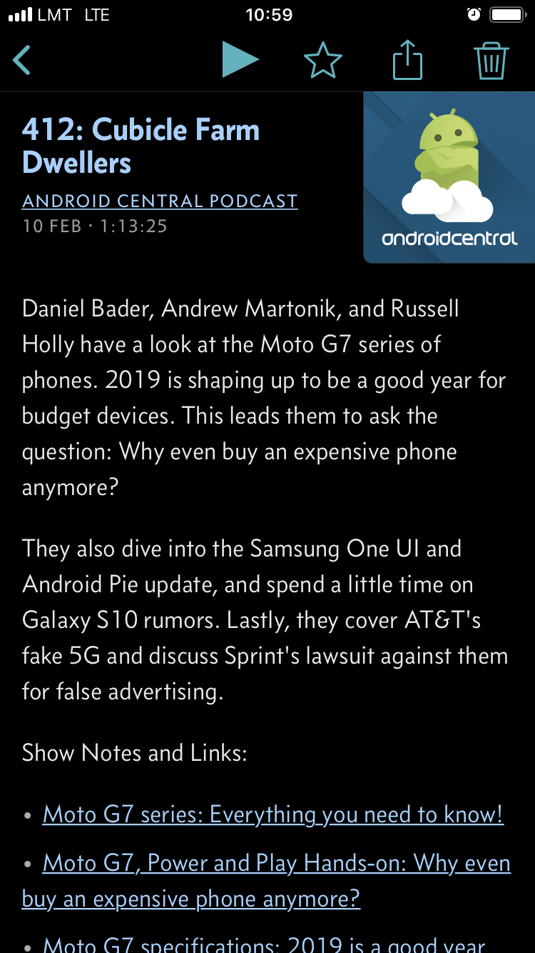
Listen podcasts
Keep up with the industry while you commute, exercise or doing routine work
Listen developer oriented or market oriented
Developers – increase your skill, introduce to the new technologies
Market – increase your awareness of market needs, you would know whats in demand

Slide 46
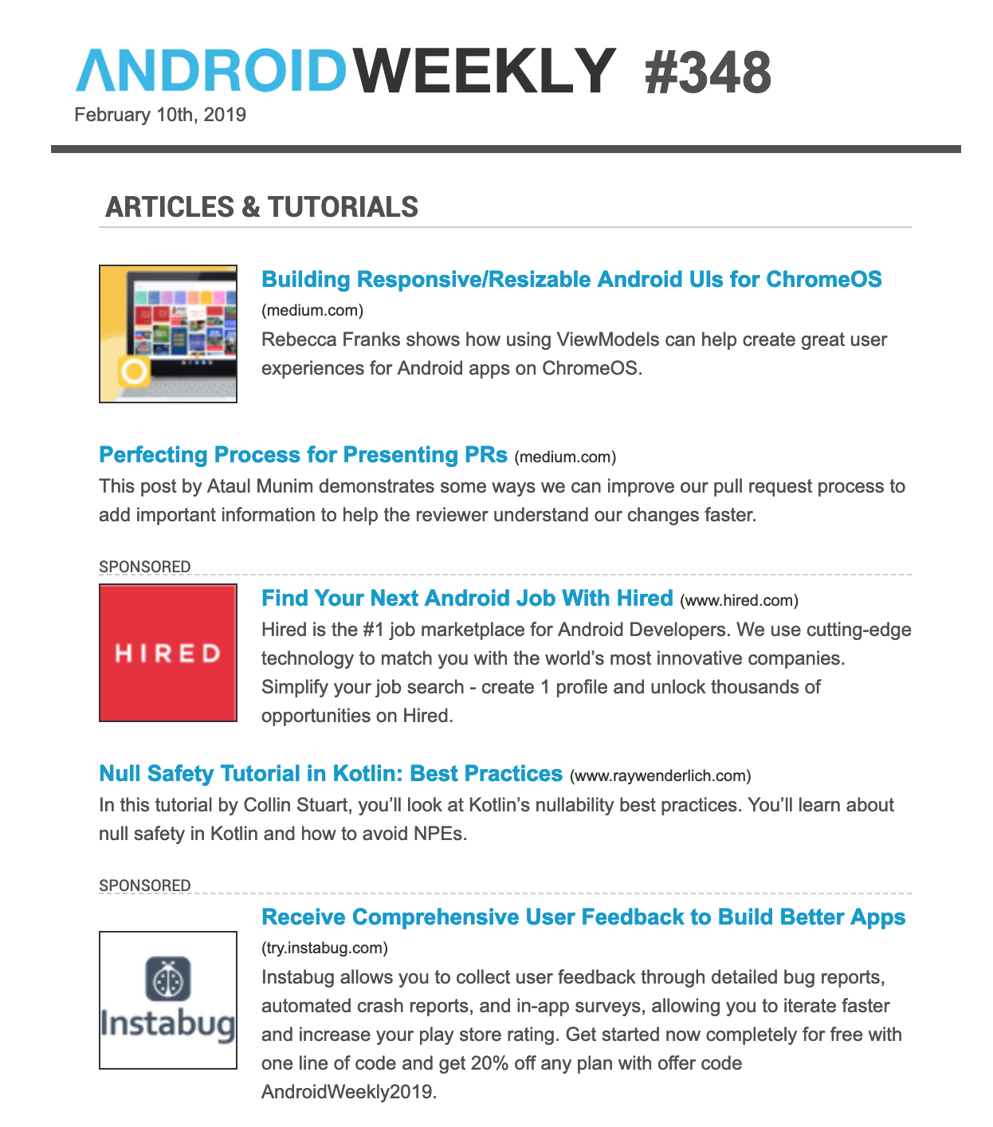
Mailing lists Android
Search for Android mailing lists that sum up everything that happens in Android community during the week and sends that to you once a week. Even if you don’t understand a thing, dedicate a time, for example 30 minute and just read stuff, inevitably you would begin to understand.
http://androidweekly.net/

Slide 47

Mailing lists Kotlin
Kotlin became more and more popular, Its better to start learning it now rather then in 5 years when everyone would be asking for it ☺
http://kotlinweekly.net/

Slide 48
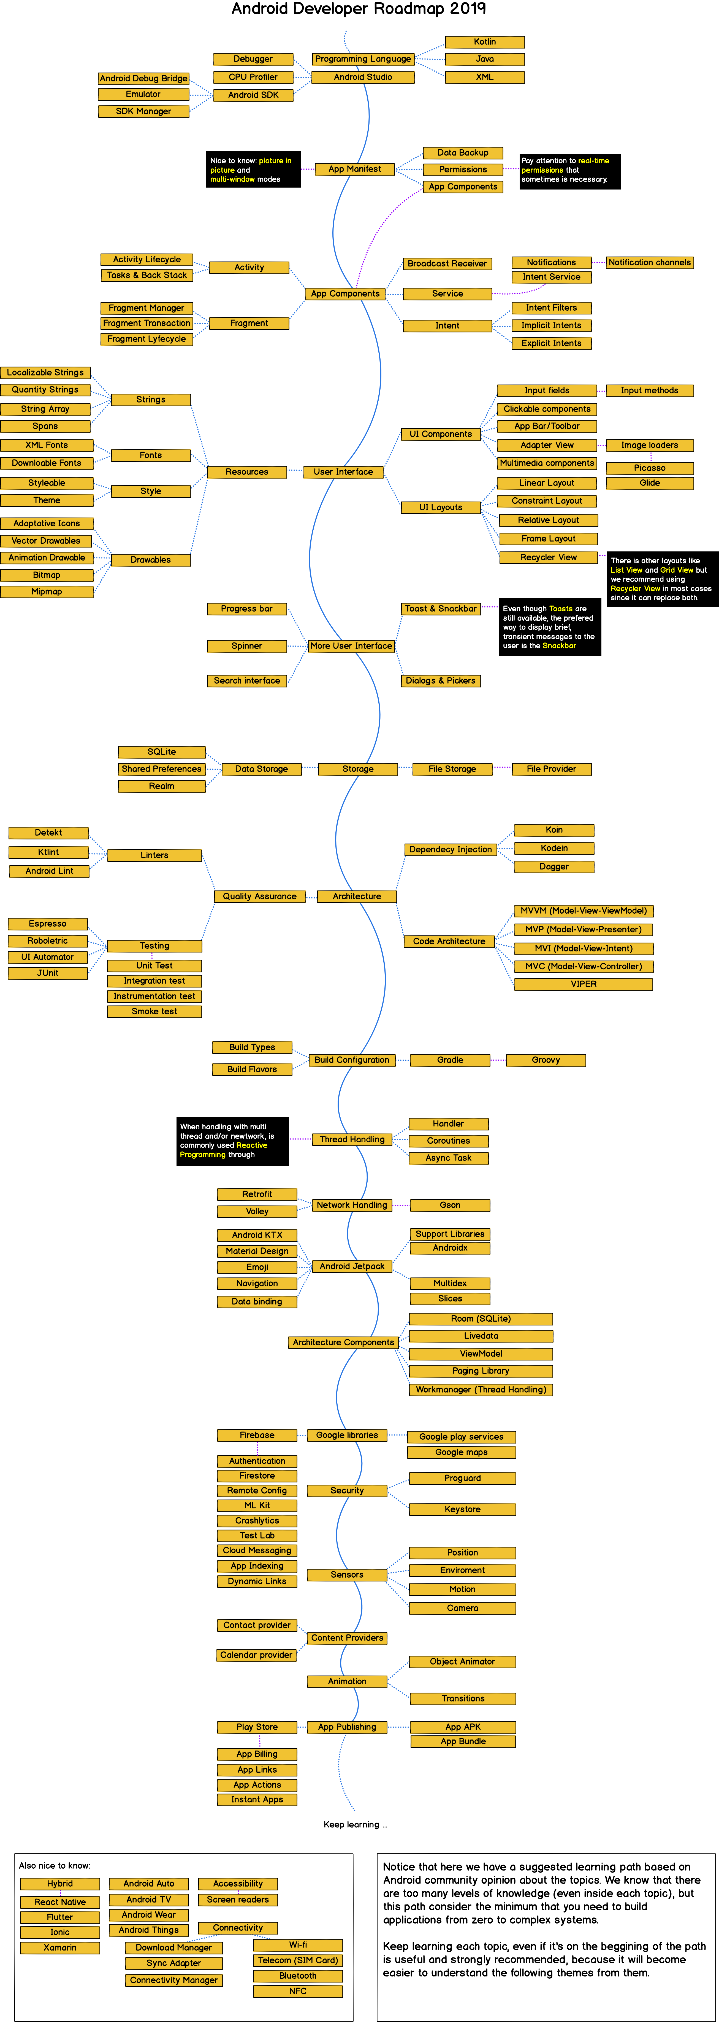
Learning path
“Save as” to view in full size

Slide 49
Local meetups (Meetup.com/facebook)

Slide 50
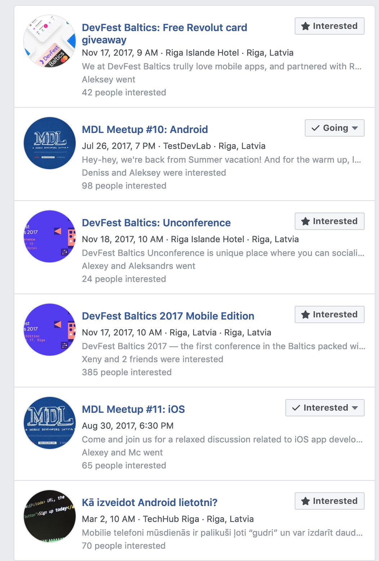
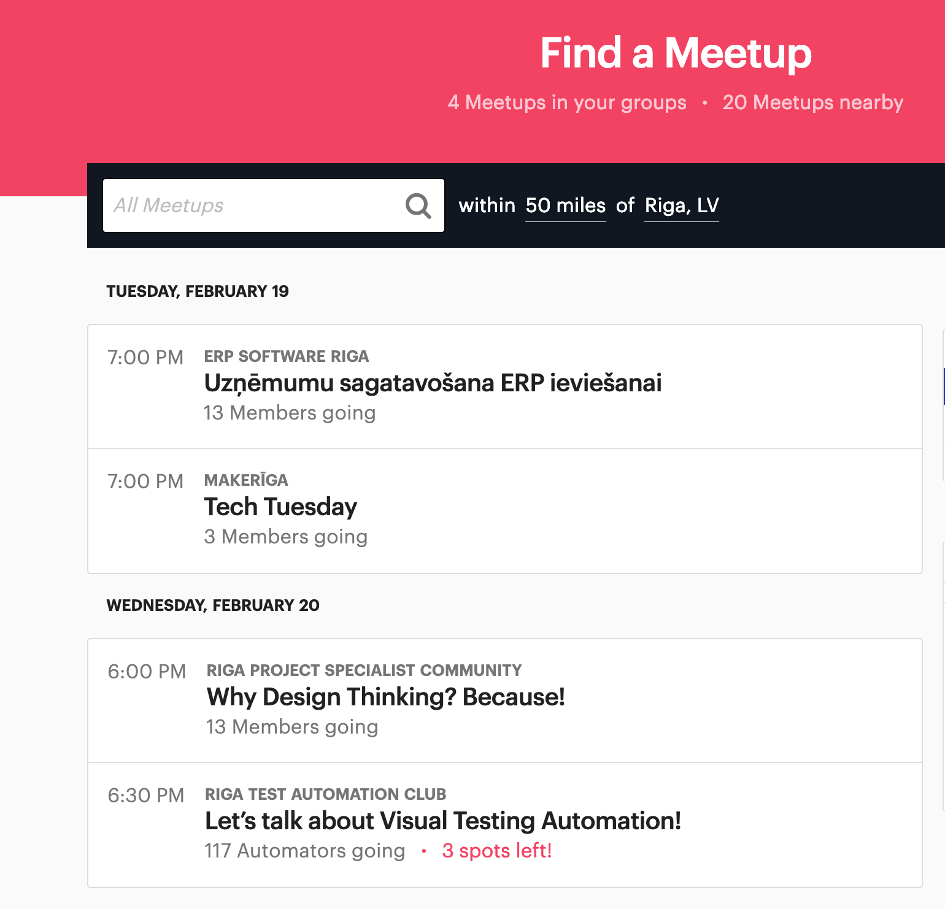

Slide 51
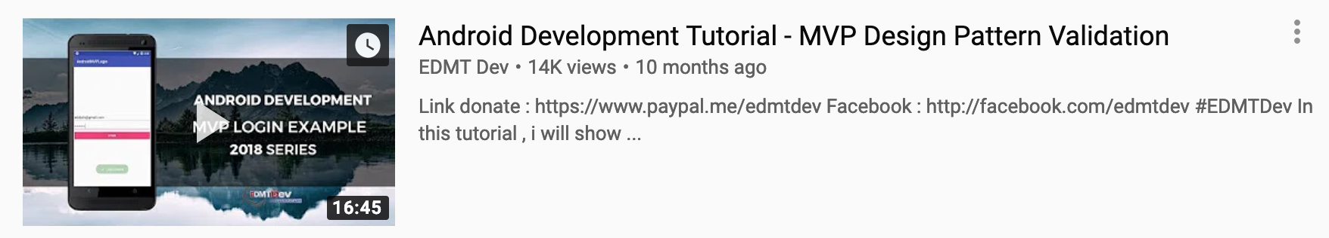
Watch conferences & tutorials
There are a few big one, like Google presentation of a new Android and smaller one where developers share their knowledge on a particular topics.
Watch Google when new Android came out to find out what are the new possibilities, and maybe you would came out with a great app to do!
Watch community videos to get expertise in arthitectues, framework featues or on how to build Android app businnes.

Slide 52
Best strategy for Entering Android Development
Finish this course – Well Done!
Create 2-3 your own apps. Do a simple things like weather app, latest films app, news aggregator app, step counter and etc.
Try to find local job with that portfolio
When you get some experience, try to do a freelance work
Grow from there

Slide 53
Resources
Icons https://www.flaticon.com/home
Screenshots https://screenshot-maker.appinstitute.com/app-screenshot-maker/getstarted

Slide 54
Thanks for attending!!
You could always reach me via: deniss.kaibagarovs@gmail.com
www.kaibagarovs.com
Twitter – @TheTaier (dev memes)

